Slide 1
Statistical methods in Microbiome analysis
Dhiraj Dhotre

Slide 2
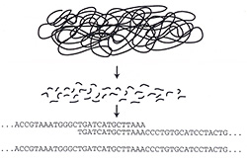
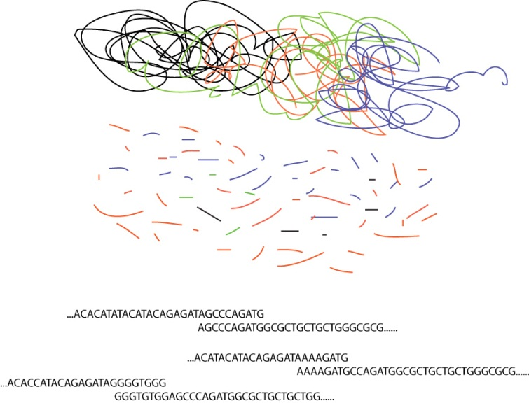
Whole Gene Shotgun Sequencing for Metagenomics
One genome
Random genome
fragmentation
Multiple genomes
Genome assembly
using overlaps
Random genomes
fragmentation
Genomes assembly
using overlaps

Slide 3
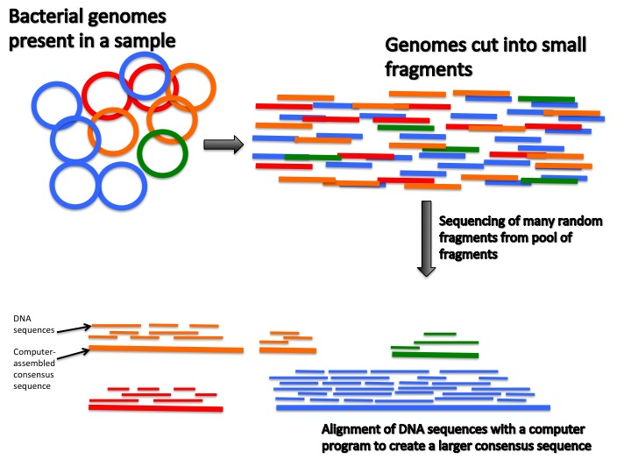

Slide 4
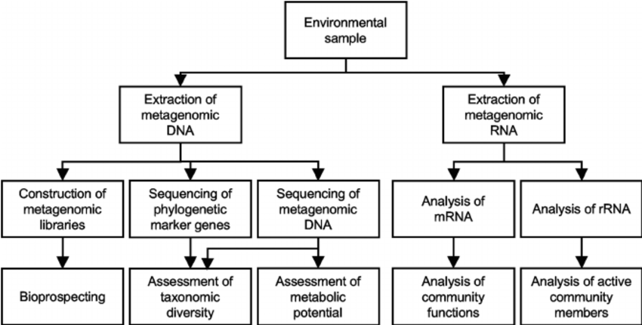
Ways to understand metagenome
Applied and Environmental Microbiology 77(4):1153-61 · February 2011

Slide 5
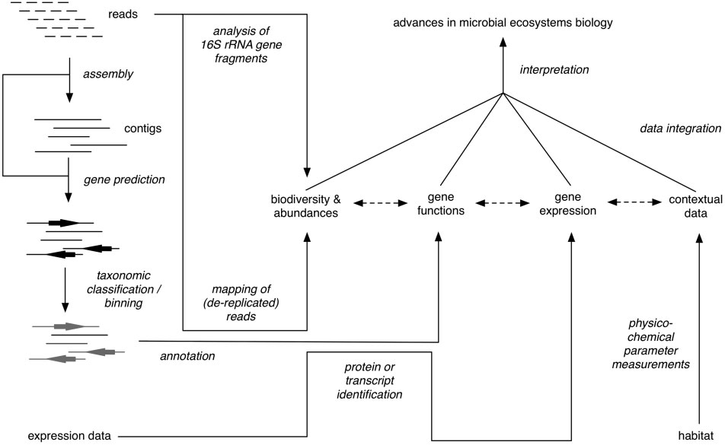
Scheme of the major stages of an integrative metagenomic ecosystems study on microbial ecology.
Teeling H et. al. 2012 briefing in bioinformatics Vol 13 No 6 728-742

Slide 6
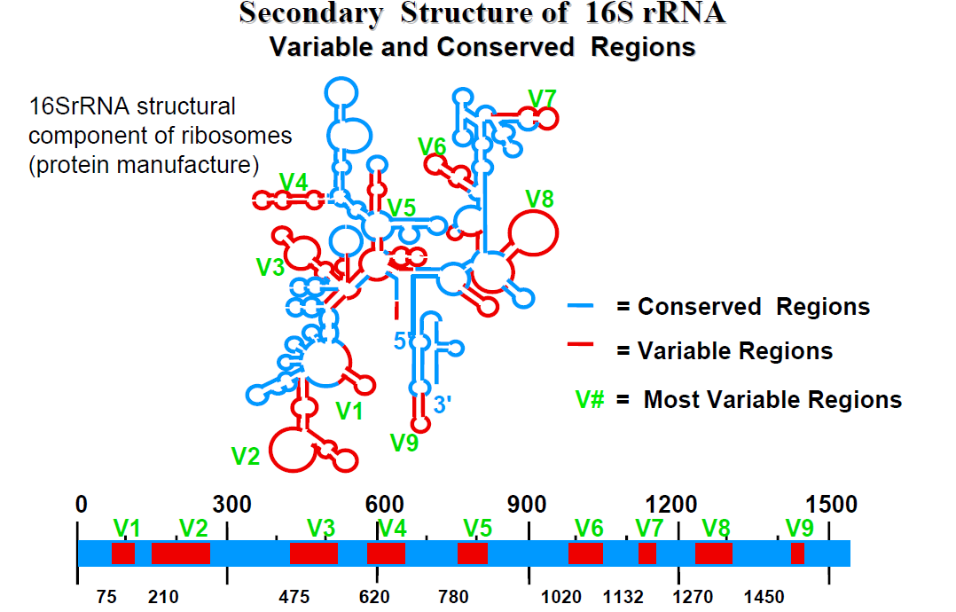
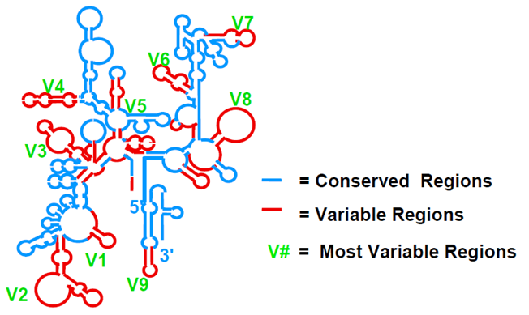
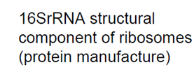

Slide 7
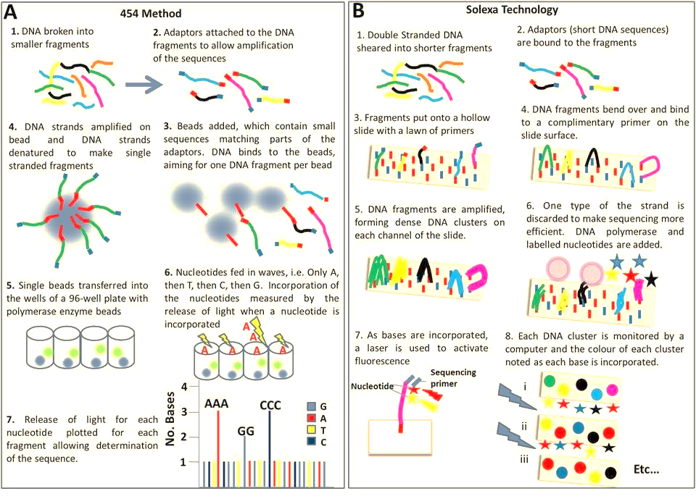
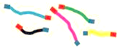
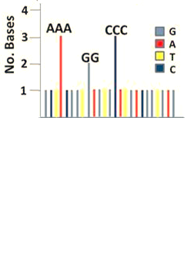

1. DNA is fragmented into smaller pieces
2. Adaptors attached to the DNA fragments to allow amplification of the sequences
3. Beads are added
7. Change in pH or Released light for each nucleotide is plotted for each fragment allowing determination of sequence
Steps of Next generation sequencing
By 454 and ion torrent
4. DNA is clonally amplified on beads using emulsion PCR
6. Nucleotide fed in waves, i.e one nucleotide at one time. Incorporation of nucleotide is measured by the pH change (PGM, ABI) or released pyro-phosphate (454 sequencing)
5. Single beads Loaded into the chip having millions of wells

Slide 8
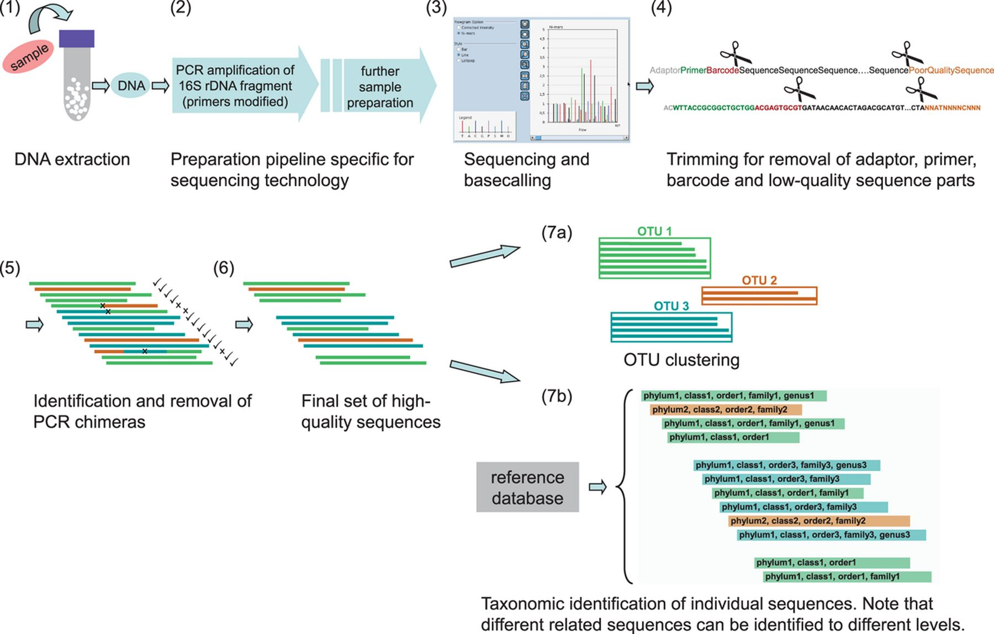
Ines Yang et al 2013 FEMA Microbiology Reviews

Slide 9
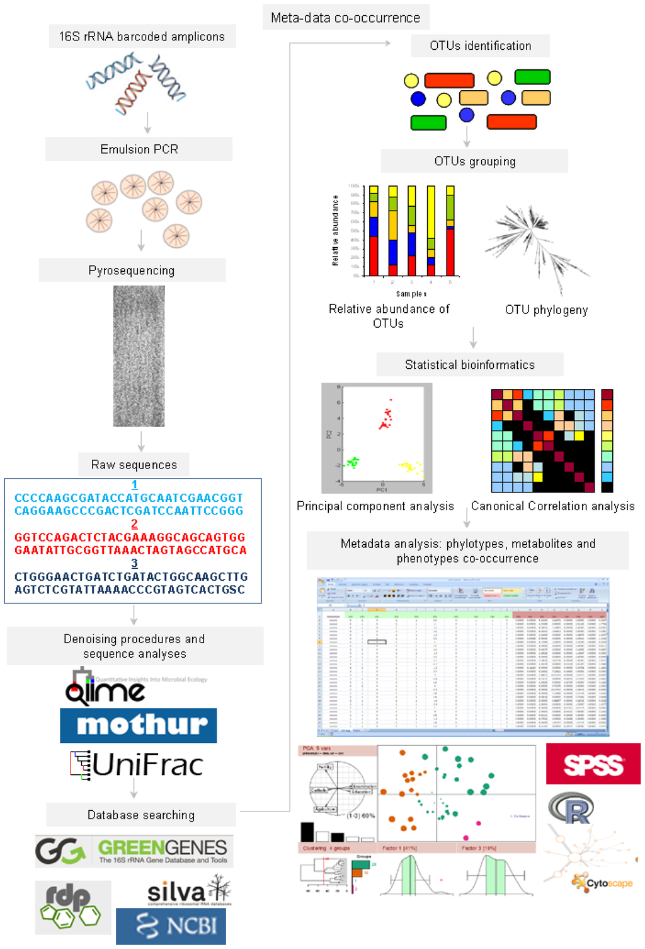
Int. J. Mol. Sci. 2014, 15(1), 684-711

Slide 10
Research Questions
How many different organisms (diversity)
Have we capture all the diversity?
What is the abundance of each OTUs
Comparison with other samples

Slide 11
Steps in analysis
Demultiplexing of reads
FastQC
Assemble paired end reads
Rename or change sequence name
Create a metadata file
Cluster OTUs
Representative sequences
Assign taxonomy

Slide 12
Steps in analysis
Normalize data
Alpha diversity analysis
Rarefaction
Richness estimators, diversity Index, Good’s coverage
Beta diversity analysis
Unifrac, Bray Curtis, Euclidean
PCA/PCoA/NMDS
Significance testing

Slide 13
Steps in analysis
Statistical analysis
Interpretation of the results
Submission of the data

Slide 14
Some concepts
OTU clustering methods
Open reference
Closed reference
De novo
Databases -> SILVA, Greengenes, RDP for 16S rRNA gene and UNITE for fungal ITS
Representative sequences
Normalization

Slide 15
Some concepts
Relative and absolute abundance
Microbial Diversity and abundance
Rarefaction
Chao, Simpson, Shannon etc
Alpha and beta diversity
OTU heatmap
OTU network

Slide 16
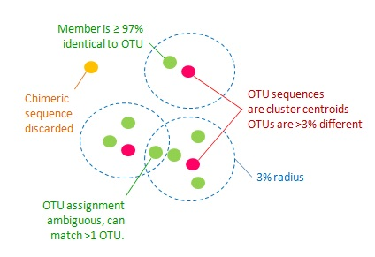
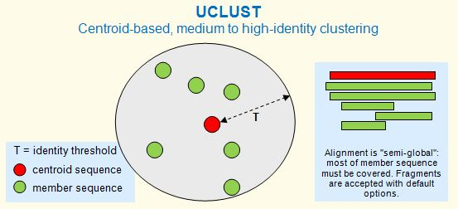
OTU clustering

Slide 17

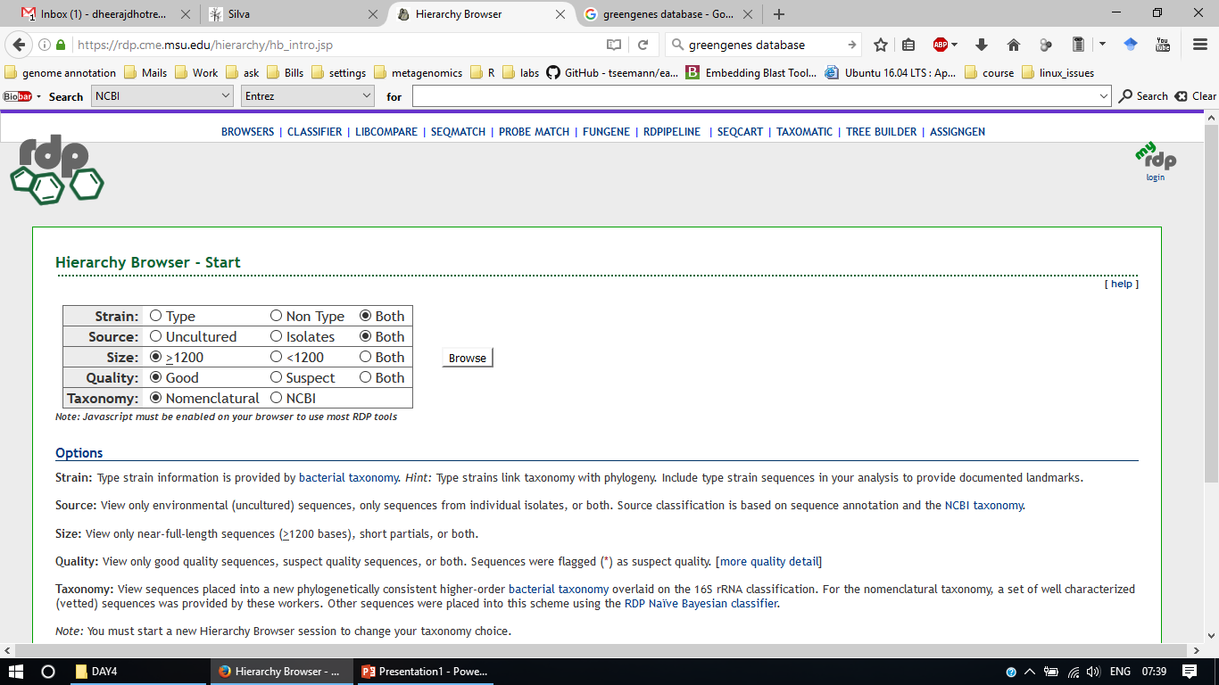
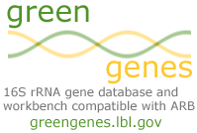
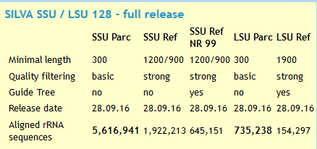
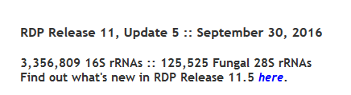
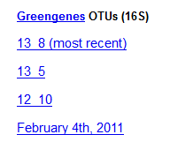
Taxonomic assignment

Slide 18
Alpha diversity
Estimators of within-community (alpha) diversity have been proposed and refined for decades (Whittaker, 1972; Magurran, 2004).
For NGS surveys of bacterial symbionts, three measurements of alpha diversity are commonly used: rarefaction curves, species richness estimators (often in conjunction with rarefaction curves), and community diversity indices.
Recently, a method to account for 16S gene copy number in estimating bacterial abundance was developed (Kembel et al., 2012), which may help improve the accuracy of bacterial diversity measurements based on 16S amplicons.

Slide 19

Species richness estimators: Chao1
Species richness estimators estimate the total number of species present in a community. The Chao 1 index is commonly used, and is based upon the number of rare classes (i.e. OTUs) found in a sample (Chao, 1984)
where S_{est} is the estimated number of species, S_{obs} is the observed number of species, f₁ is the number of singleton taxa (taxa represented by a single read in that community), and f₂ is the number of doubleton taxa. If a sample contains many singletons, it is likely that more undetected OTUs exist, and the Chao 1 index will estimate greater species richness than it would for a sample without rare OTUs.

Slide 20
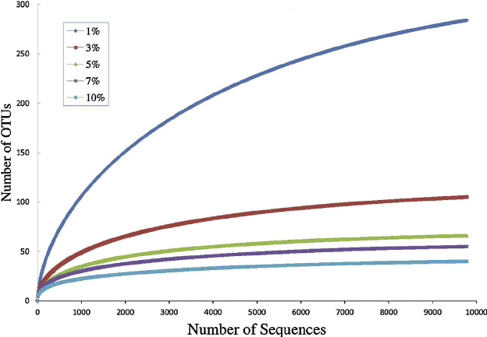
Rarefaction Curve
Rarefaction curves are used to determine whether sampling depth was sufficient to accurately characterize the bacterial community being studied. To build rarefaction curves, each community is randomly subsampled without replacement at different intervals, and the average number of OTUs at each interval is plotted against the size of the subsample (Gotelli and Colwell, 2001). The point at which the number of OTUs does not increase with further sampling is the point at which enough samples have been taken to accurately characterize the community.

Slide 21

Diversity Indices
Community diversity indices combine species richness and abundance into a single value of evenness. Communities that are numerically dominated by one or a few species exhibit low evenness while communities where abundance is distributed equally amongst species exhibit high evenness (Gotelli, 2008). Two of the most widely used indices are the Shannon (or Shannon-Wiener) index (Shannon, 1948) and Simpson’s index (Simpson, 1949).

Slide 22
Beta diversity
The main goal of most bacterial community studies is to compare the composition of different communities (beta diversity).
The communities being compared differ in some trait or treatment, such as which section of the gut the samples are from.
There are numerous ways to visualize and analyse beta diversity, and a thorough review of multivariate techniques that are commonly used by microbial ecologists is presented by Ramette (2007).

Slide 23
Matrices
Determine the distance/dissimilarity matrix. The goal of ordination and clustering is to visually compare community composition. Both approaches utilize community distance matrices as input
Beta diversity compares between sample diversity, and is often calculated by comparing feature dissimilarity, resulting in a distance matrix between all pairs of samples.
One conventional calculation for beta diversity is the Bray–Curtis dissimilarity, which is a quantitative measure that accounts for taxa abundance when comparing two communities.

Slide 24
Beta diversity
In addition to taxa abundances, Weighted Unifrac distance also takes into consideration phylogenetic relatedness when measuring the differences in two communities.
Unweighted Unifrac distance, on the other hand, is a qualitative measure which only considers the presence and absence of taxa.
Both Unifrac measurements require a phylogenetic tree as the scores are derived by calculating total branch distances between shared and unshared bacteria on a phylogenetic tree.
The Jaccard index, or similarity coefficient, is another qualitative measurement that does not consider relative abundances, but feature presence/absence [65].
By evaluating taxa presence, absence, and abundances one can investigate the extent of the difference between the compositions of communities between samples. If possible, the addition of relatedness allows for the potential to assess evolutionary divergence.

Slide 25
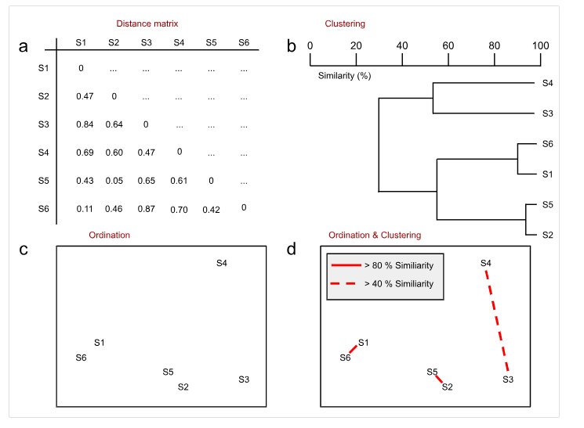
Clustering and Ordination
Figure 1: A distance matrix (a) provides input for both b) hierarchical cluster analysis and c) non-metric dimensional scaling. The results of the cluster analysis may be superimposed on the ordination (d) to validate that each solution corroborates the other. Adapted from Ramette 2007, originally adapted from Legendre & Legendre 1998.

Slide 26
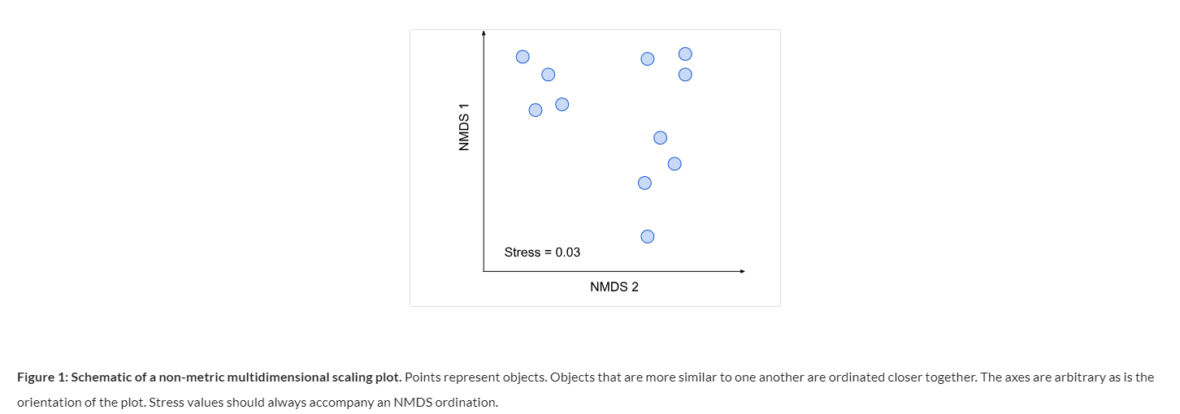
NMDS-Non-metric multidimensional scaling

Slide 27
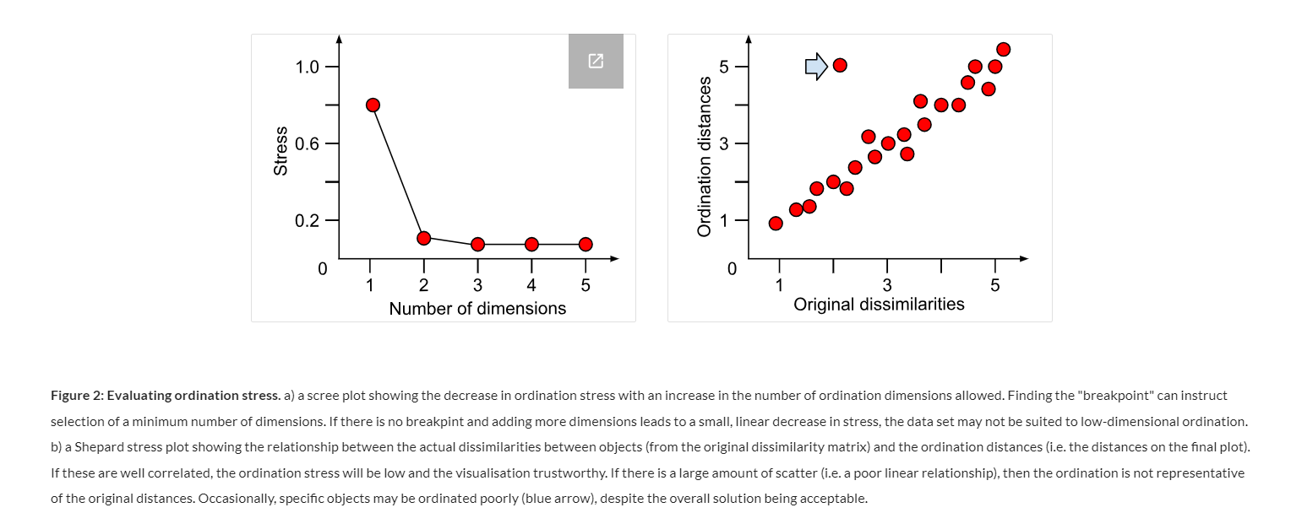
NMDS-Non-metric multidimensional scaling

Slide 28
Ordination and Clustering
Evaluate ordination patterns. The Bray-Curtis dissimilarity matrix or UniFrac distance matrix is used as input for ordination and clustering analyses.
The two most common methods for ordination of NGS bacterial community data are principal coordinates (PCoA) and nonmetric multidimensional scaling (NMDS).

Slide 29
Hierarchical clustering
To visualize community relatedness in the same format as a phylogenetic tree, we recommend UPGMA, or the Unweighted Pair Group Method with Arithmetic mean (Sokal and Michener 1958).
Jackknife support for the branching patterns in the resulting dendrogram can be calculated in QIIME (Kuczynski et al., 2011), providing an estimate of confidence in the clustering patterns.
Methods
Ward´s linkage is a method
Single linkage
Complete linkage
Average linkage

Slide 30
Dada2 and Phyloseq (in R)
Dada2
Introduction to dada2 (bioconductor.org)
DADA2 — Microbial Bioinformatics Hub documentation (microbial-bioinformatics-hub.readthedocs.io)
DADA2 Pipeline Tutorial (1.8) (benjjneb.github.io)
Phyloseq
An introduction to the downstream analysis with R and phyloseq — micca 1.7.0 documentation
The phyloseq Tutorials Index (joey711.github.io)
Phyloseq tutorial (vaulot.github.io)

Slide 31
https://sites.google.com/site/mb3gustame/

Slide 32
Statistical methods to learn
Training model for error correction (dada2)
Filtering methods
Inter-quantile range
Standard deviation
Coefficient of variation
Data normalization
Rarefying
Data scaling
Total sum scaling
Cumulative sum scaling
Upper-quartile normalization

Slide 33
Statistical methods to learn
Data transformation
RLE (Relative log expression)
CLR (Centre log ratio)
Alpha diversity
Richness estimators
Diversity indices
Evenness estimators
Beta diversity
Ordination analysis
Principal component analysis
Principal coordinate analysis
Multidimensional scaling (MDS)
Distance methods
Bray Curtis
Jaccard
Sorenson’s distance
UniFrac and Weighted UniFrac

Slide 34
Statistical methods to learn
Significance tests
T-test
ANOVA
PERMANOVA
Adonis test
Correlation analysis
Regression analysis
Error correction
FDR (False discovery rate)
Benjamini–Hochberg
Comparison analysis
Single factor and multifactor analysis
Random forest

